Slide 1
Task 3: Fake News Detection Submitted by : Korthiwada Shashank
First, EDA is performed on the given dataset using python and following observations are made:
Dataset consists of three columns that are useful for the analysis.
Duplicate rows are found and are removed.
Label column has two classes (FAKE or REAL)
These classes are found to be balanced (FAKE entries =3152, REAL entries = 3154 )
Labels are encoded as follows (FAKE:1,REAL:0)
Now, a small subset of the dataset is analysed first for text pre-processing, feature extraction and model fitting

Slide 2
Text Pre-processing
Various functions are defined to clean the data and these are as follows:
Normalizing URL (replacing url’s with ‘someurl’)
Normalizing email (replacing email with ‘someemail’)
Normalizing username handles (replacing handles with ‘somehandle’)
Tokenizing the text
Removing characters with are non-ASCII
Lower-casing the tokens
Removing punctuations
Replacing numbers
Removing stop words
Stemming
Lemmatization

Slide 3
Among all these, different combinations of Normalizing urls, replacing numbers and stemming are tried to see if performance gets improved on various algorithms.
Two types of features are extracted from the tokens obtained after cleaning them using the above defined functions, these are:
Count Vectors
TF-IDF vectors
Ten different algorithms are considered, these are
K Nearest Neighbours
Decision Tree
Nearest Centroid
Naïve Bayes classifier
Logistic Regression
SVC with linear kernel
SGD Classifier
Random Forest Classifier
Gradient Boosting
Extreme Gradient Boosting classifier

Slide 4
After trying all these combinations on a smaller dataset, they are applied to complete dataset and following results are obtained:
SGD classifier gives best result (accuracy : 93.85, f1 score : 0.937) followed by SVC with linear kernel (accuracy : 93.53, f1 score : 0.934) and then Logistic Regression (accuracy : 92.2, f1 score : 0.922).
SVC with linear kernel takes relatively more time in training than the other two.
Focus is made on improving these classifiers using hyper-parameter tuning.
Upon observing the scores (accuracy and f1 scores) on these classifiers on training data , it is found that these classifiers fit to training data to above 98 %. So, further tuning may lead to overfitting and thus the default hyper-parameter can be taken as best parameters.
Analysing the results by various estimators/algorithms based on given data, I would suggest Riveldy to use SGD Classifier for detecting fake posts, as it is not only giving best results, but also fast and computationally efficient in dealing with large datasets (because of use of Stochastic Gradient Decent optimization instead of Gradient Descent)
*results obtained using various algorithms are in following slides

Slide 5
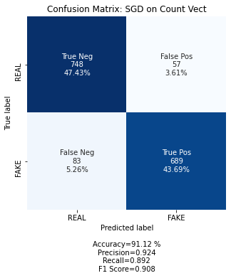
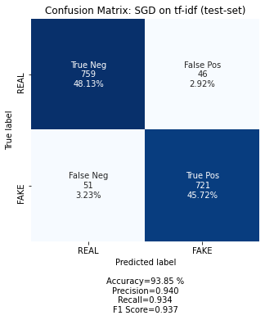
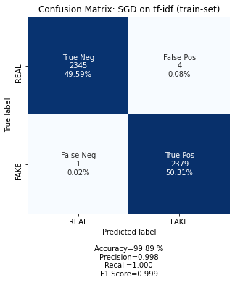
1. SGD Classifier: (a) Count Vect features, (b) TF-IDF Features
(a)
(b)

Slide 6
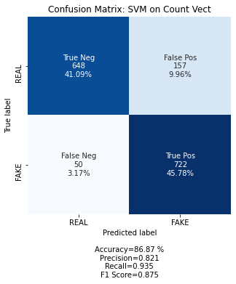
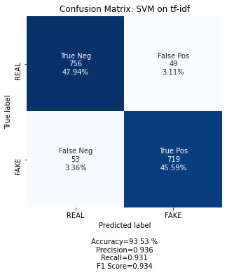

2. SVC: (a) Count Vect features, (b) TF-IDF Features
(a)
(b)

Slide 7
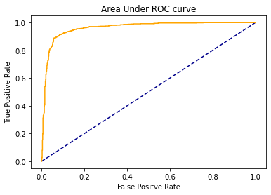
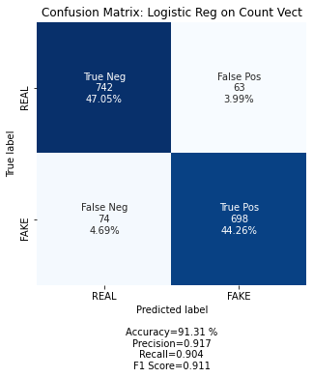
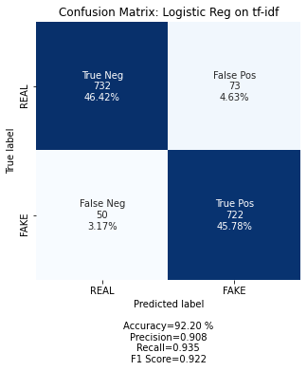
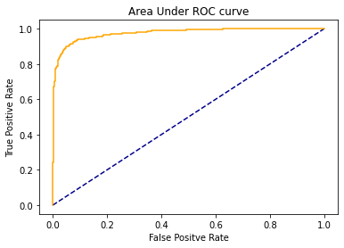
3. Logistic Regression: (a) Count Vect features, (b) TF-IDF Features
(a)
(a)
(b)
(b)

Slide 8
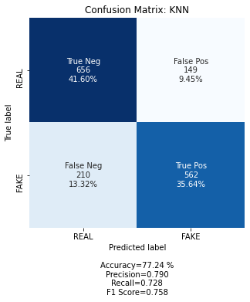
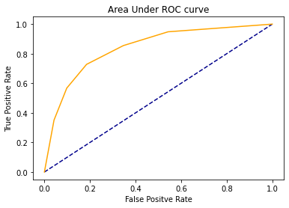
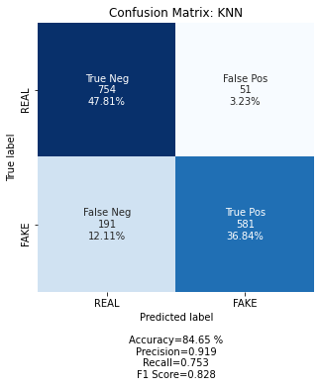
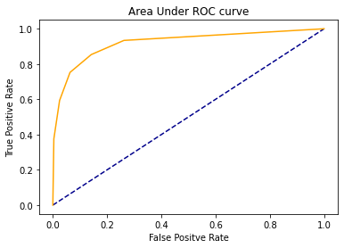
4. KNN: (a) Count Vect features, (b) TF-IDF Features
(a)
(a)
(b)
(b)

Slide 9
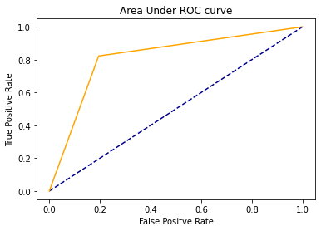
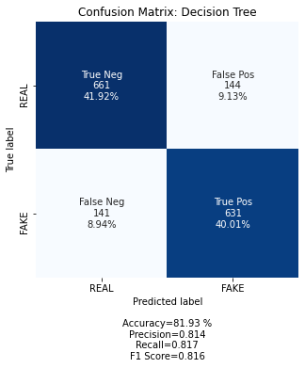

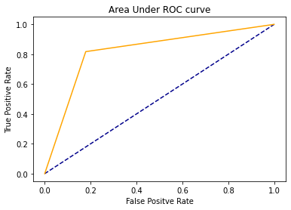
5. Decision Tree: (a) Count Vect features, (b) TF-IDF Features
(a)
(a)
(b)
(b)

Slide 10
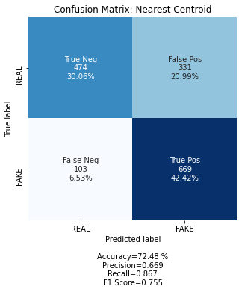
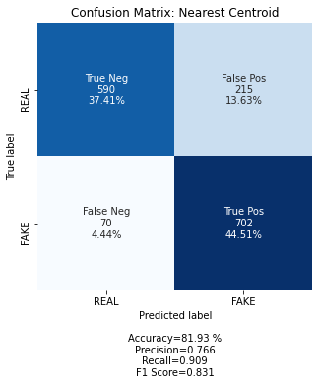
6. Nearest Centroid: (a) Count Vect features, (b) TF-IDF Features
(a)
(b)

Slide 11

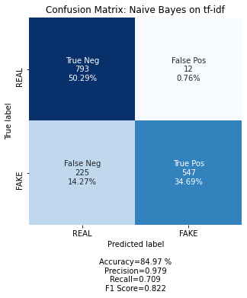
7. Naive Bayes Classifier: (a) Count Vect features, (b) TF-IDF Features
(a)
(b)

Slide 12
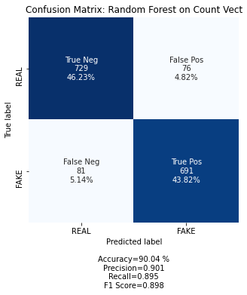
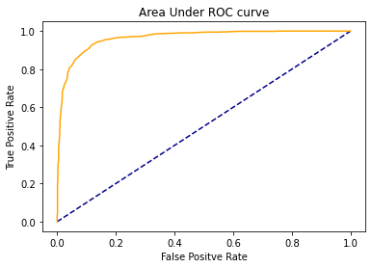

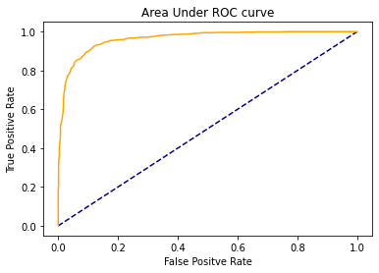
8. Random Forest Classifier: (a) Count Vect features, (b) TF-IDF Features
(a)
(a)
(b)
(b)

Slide 13
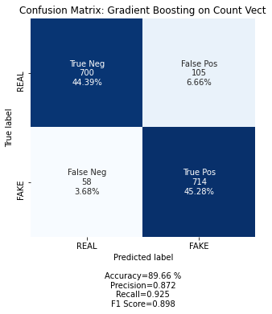

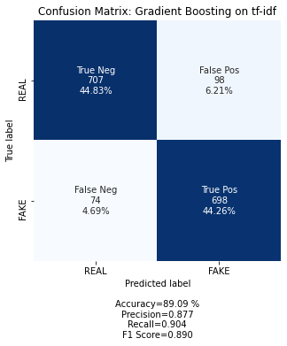
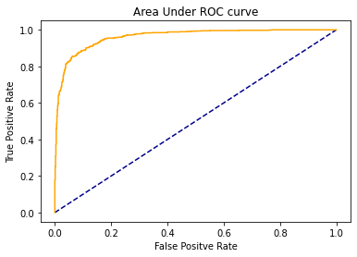
9. Gradient Boosting Classifier: (a) Count Vect features, (b) TF-IDF Features
(a)
(b)
(a)
(b)

Slide 14


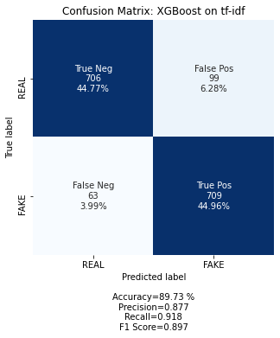
10. Extreme Gradient Boosting Classifier: (a) Count Vect features, (b) TF-IDF Features
(a)
(a)
(b)
(b)

